Slide 1

RIO GRANDE COUNCIL
BOY SCOUTS OF AMERICA
2015 Fall Round-up

Slide 2

2015 Fall Round-up
New Fall Membership Round-up using the best practices for recruiting:
New Cub Scouts
New Adult Volunteers
* Growing Stronger Cub Scout Packs
* Year Round Recruiting!
Hi I’m Ethan the New Cub Scout Champion!

Slide 3
The Boy Scouts of America is a volunteer driven organization guided and supported by a professional staff
New to 2015
Volunteer driven
Professionally guided and supported
New Recruiting material
Unit Membership Chair
Pinewood Derby Kits for every New Cub Scout

Slide 4

Human Resources to Grow Scouting
Unit Membership Chair
Unit Leaders and Unit Committees
District Membership Teams
Scout volunteers
Adult Members of the Order of the Arrow
Council Staff

Slide 6
Fall Round-up Timeline
First 60 Days: August 24 – Oct 24
Labor Day, September 7, 2015
Tuesday, Wednesday & Thursday – Round-ups
Monday, Tuesday & Wednesday – Boy Talks
First set of flyers to go out 8-10 days before round-up
Posters & yard signs up, week before round-up
Second set of flyers given at Boy Talk day before round-up
Work smart through Unit Membership Chairs working closely with District Executives to schedule Boy Talks and Round-up.

Slide 7
Round-up Time
6:00 pm
6:30 pm
7:00 pm
Strive for a set time
Work with Unit Membership Chair and your District Executives to coordinate Round-up times. Think of the parent’s travel time from work to house and to the school cafeteria.

Slide 8
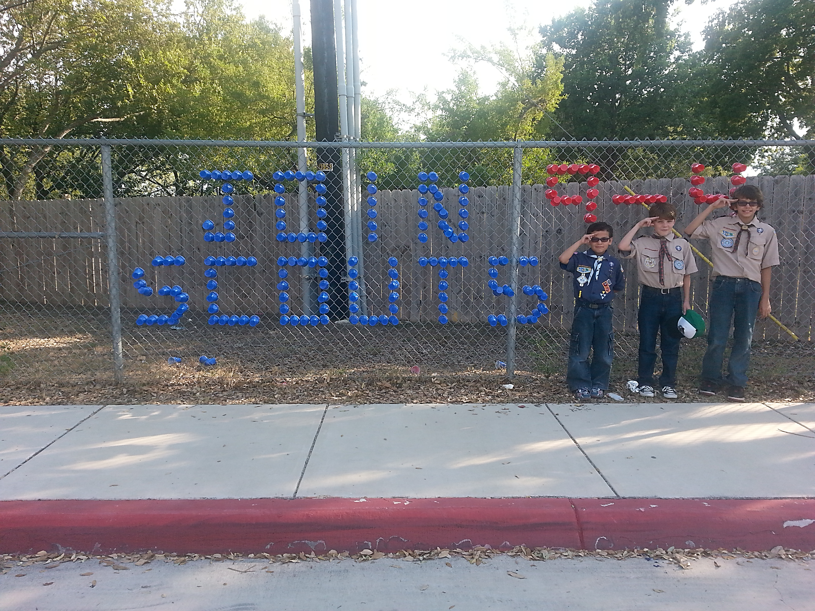
Promote Round-up 10 times
Fall Round up Night
Open House/Meet the Teacher
Posters
Flyers
Yard Signs
Boy Talk Flyers
Social Media
Boy Talks
You Tube Videos
Marquis
School announcements

Slide 9
Boy Talk By Lupe Valdez

Slide 10
Boy Talk
Monday, Tuesday & Wednesday: Boy Talk
Day before Round-up
Always face to face for best practice. Avoid shortcuts.
2nd flyer given at Boy Talk
Grade by grade, Auditorium, PE Class, or Cafeteria assembly
Remember to modify Boy Talk for each grade.
Keep it short and exciting, 5 minutes only!

Slide 11
HOW TO CONDUCT THE BOY TALK
Make arrangements with school principal to conduct the Boy Talk.
Wear your uniform.
Sign-in at the school office about 15 minutes before you plan to start. Introduce yourself to the principal and the school secretary.
The actual presentation should include the agenda items on the next page.
Use gimmicks to get flyers home, such as having boys put them in their sock or a paper airplane contest, or just place in folder/backpack. Stop at the office on the way out and leave extra flyers with the school secretary.
Keep your presentation to 5 to 7 minutes. Be enthusiastic and positive! Make Cub Scouting FUN!

Slide 12
Best Practices for Boy Talks
Option 1 – Conduct Boy Talk by grade or assembly immediately after morning announcements in cafeteria. Ask school for microphone. These talks must be by grade for crowd control. *Estimated time at school one hour.
Option 2 – Conduct Boy Talk by grade during recess before or after lunch. Estimated time at school 2 hours.
Option 3 – Conduct Boy Talk by grade during P.E. Estimated time at school 4 hours.

Slide 13
Fall Round-up Unit Team
Unit Membership Chair – Main point of contact for the Pack whose sole focus is membership growth and retention for the Pack. Membership Chair is responsible for setting up the date, time and location of the Round-up. Unit Membership Chair helps keep the relationship between the Pack and School healthy and strong.
Unit Commissioner – District level help and support. The Unit Commissioner’s general experience and general knowledge of Scouting can be used to help answer questions from new parents and with general flow of the evening and with paperwork.
Den Leaders & Assistants - Den Leaders and Assistant Den Leaders should be used to help welcome new families into existing Dens. Also can help with the set and general orientation of new Dens. Den Leaders can also set up and help monitor games and activities for the boys while Pack Leadership talks to parents.
Pack Committee – Members of the Pack Committee play a very important role for your Fall Round-up. They can help secure things with the school. Depending on their role on the committee they can help with the collection of signatures (i.e. Committee Chair and COR on all adult applications) or to help collect money for registration and Boy’s Life.
Troop Leaders & Order of the Arrow Adult Members – Troop Leadership and the OA can prove to be very helpful at a Fall Round-up. Both can provide general help and support for the Round-up. If an older brother shows up of if there is a 5th grader that is already or soon to be 11, Troop Leader can register that boy into their Troop. Members of the OA can help promote the Packs out door program or help talk about the benefits of going camping or attending the local Council Day Camp.

Slide 14
Round-up basics
2 sets of flyers (1st flyer goes out 8-10 days before round-up & 2nd flyer goes out day before round-up) Must provide your district executive with contact information for recruiting flyers (Unit contact number and email, recruiting date, time, and location)
Round-up nights – Tuesday, Wednesday, and Thursday, 6 p.m., 6:30 p.m. or 7 p.m.
Stick to script to stay within an hour and half.
Boy Talks for Cub Scouts done day before round-up – Monday, Tuesday, and Wednesday.
  Boy talks must be done in 5 to 10 minute presentations.
  Preferred Boy Talk times are: 8:30 a.m. – 11:30 a.m.
Use the best practices for talking to potential Cub Scouts.
Council will provide recruiting and round-up material.
Parent Orientation to be done by the Unit Membership Chair and Pack!

Slide 15
Registration fees and application submission procedures
Turn in all applications and registration fees that night or by the next business day after round up. The registration Fee on all flyers will be $25. $24 for the membership fee and $1 for the insurance. There may be a pack fee statement and that will be added to the flyer. Boy’s Life Fee of $12 is optional.
Checks payable to the Boy Scouts of America, Rio Grande Council.
Units collecting any other fees must do so separately. It is suggested that those fees be collected at a separate meeting and not during the round- up.
Adult applications require signatures from the CC, COR. Try to get these volunteers at the round-up.
Although Boy’s life is optional it will be strongly encouraged.

Slide 17
We now have a new and improved process of turning in our membership applications.
We need your help to
Please Turn in Original Applications!
Also please make sure you have the current version of our Youth and Adult applications!
You can get them here or from your District Executive!

Slide 20
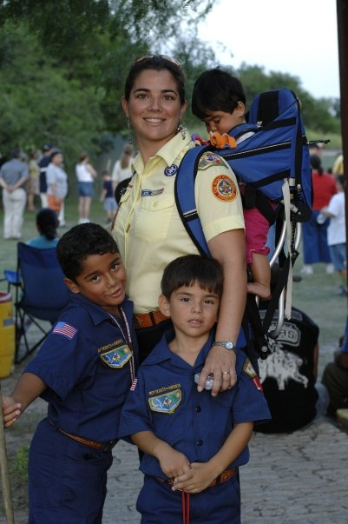
Use the best practices to grow Scouting. No shortcuts!
Boy Talks + Round-ups =

